Slide 1

Chapter 5: Interface
CSC 113: Computer programming II

Slide 2
Interface
An interface is a reference type, similar to a class, that can contain only constants and method signatures.
To define an interface use the keyword interface instead of the keyword class.
All method declarations in an interface are implicitly public, so you can omit the public modifier.
A class must implement an interface
A class implements an interface if it provides the method body to all abstract methods defined in the interface
Interfaces cannot be instantiated—they can only be implemented by classes or extended by other interfaces. Extension is discussed later in this lesson.

Slide 3
Example
public interface A {
public void x();
public double y();
}
public class B implements A {
public void x(){
}
public double y(){
//Implements the body of y
}
}
Both methods are abstract
Public can be removed

Slide 4
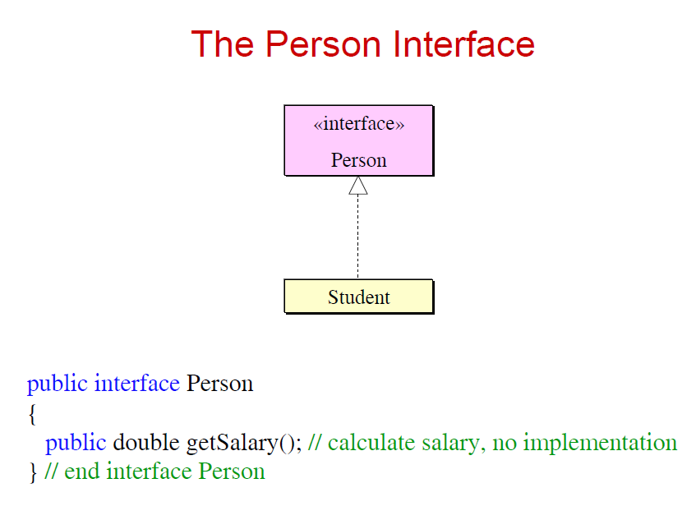
Represented in UML

Slide 5
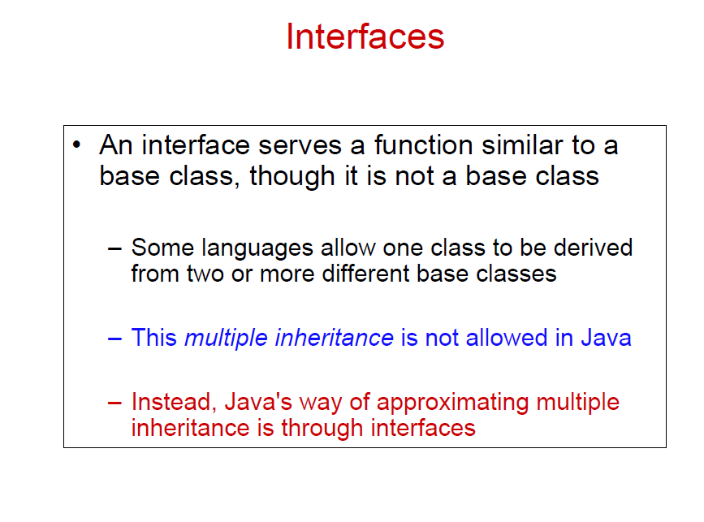

Slide 6
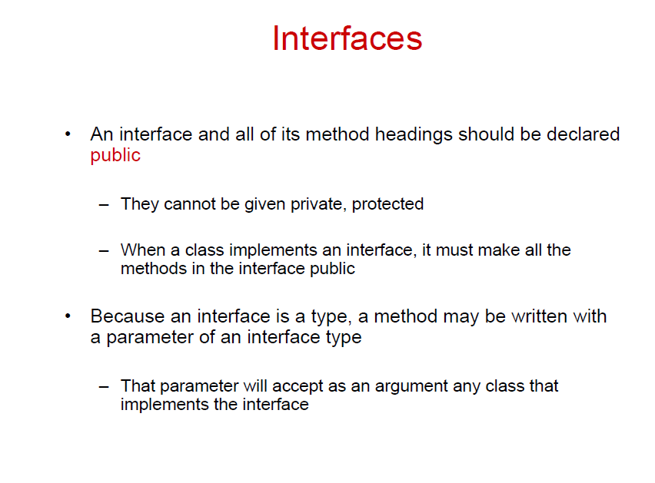

Slide 7
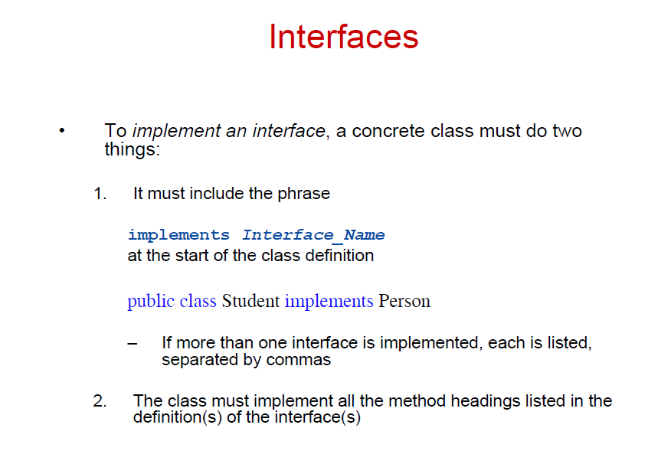

Slide 8
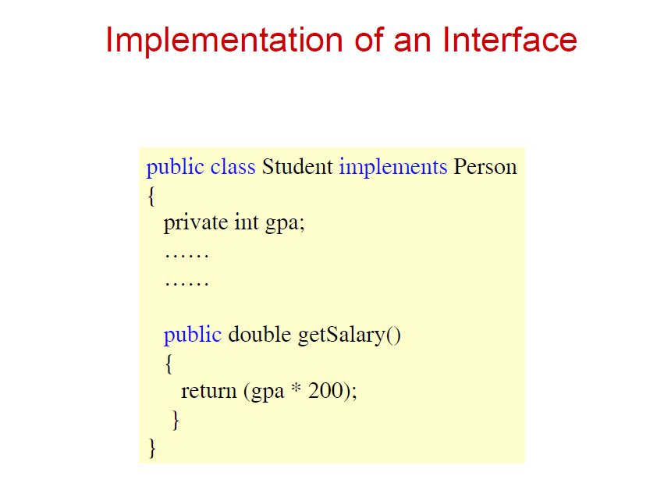

Slide 9
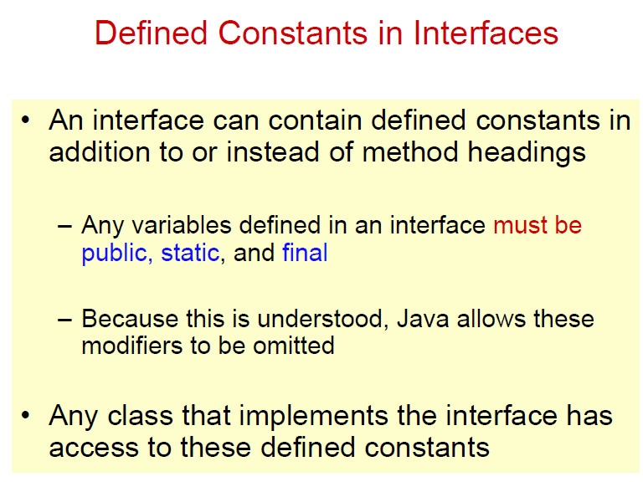

Slide 10
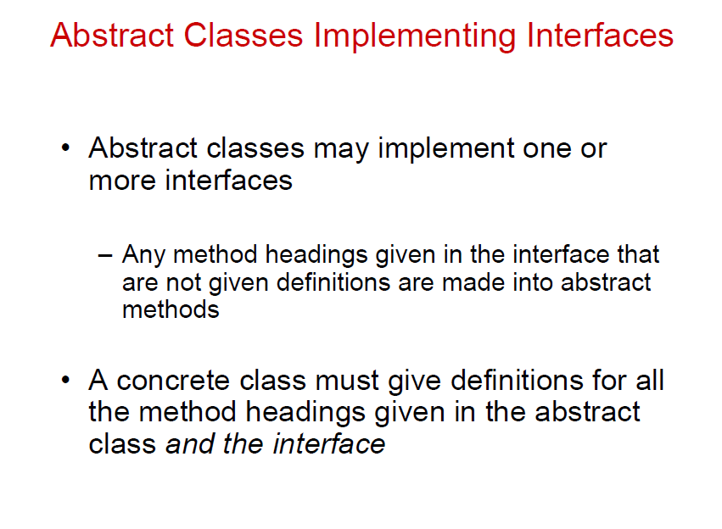

Slide 11
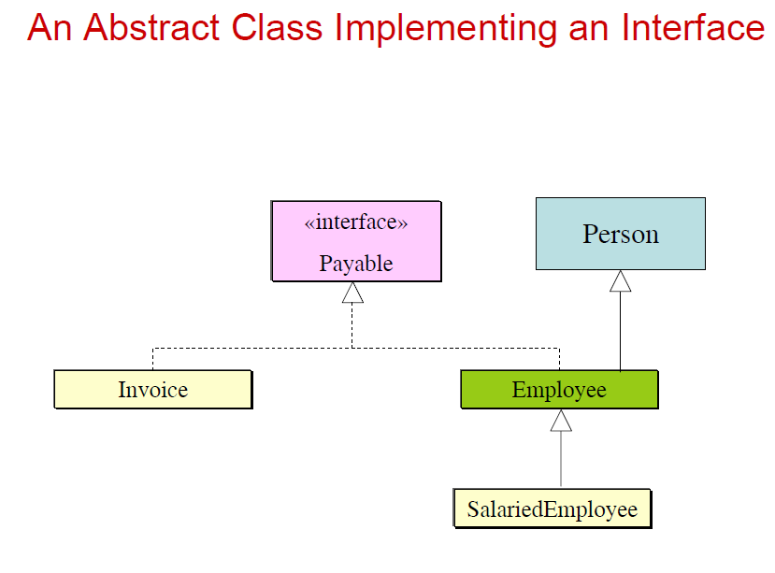

Slide 12
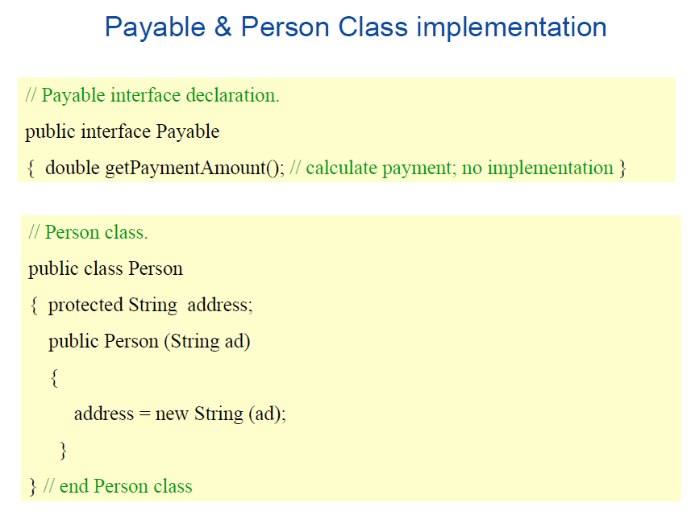

Slide 13
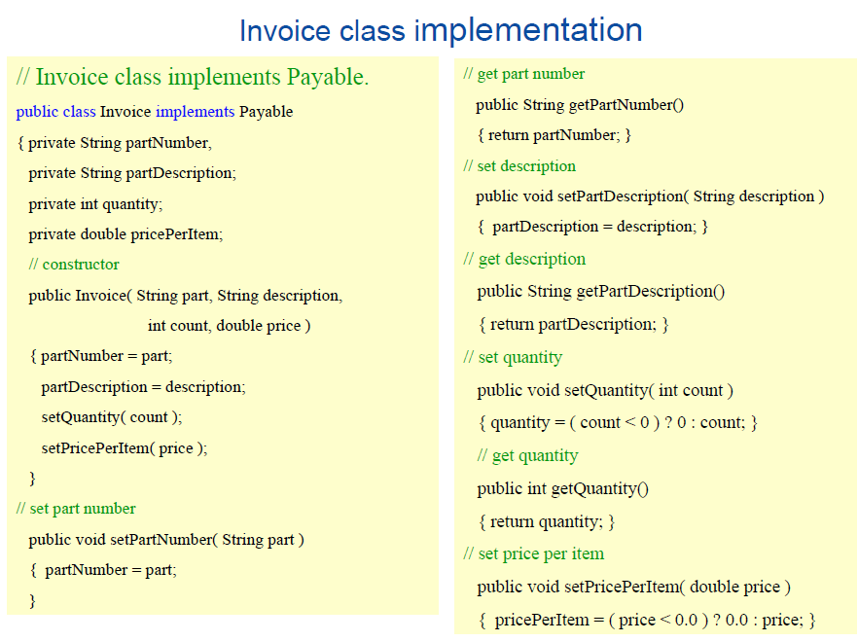

Slide 14
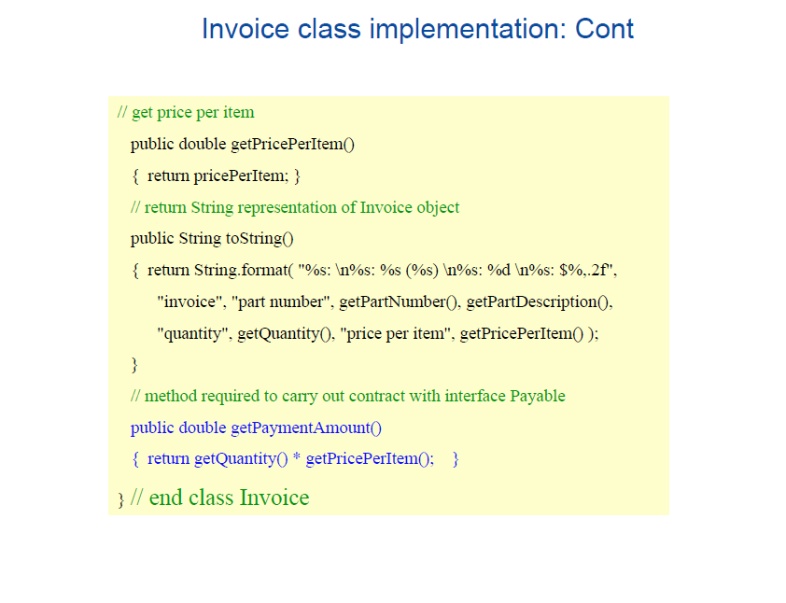

Slide 15
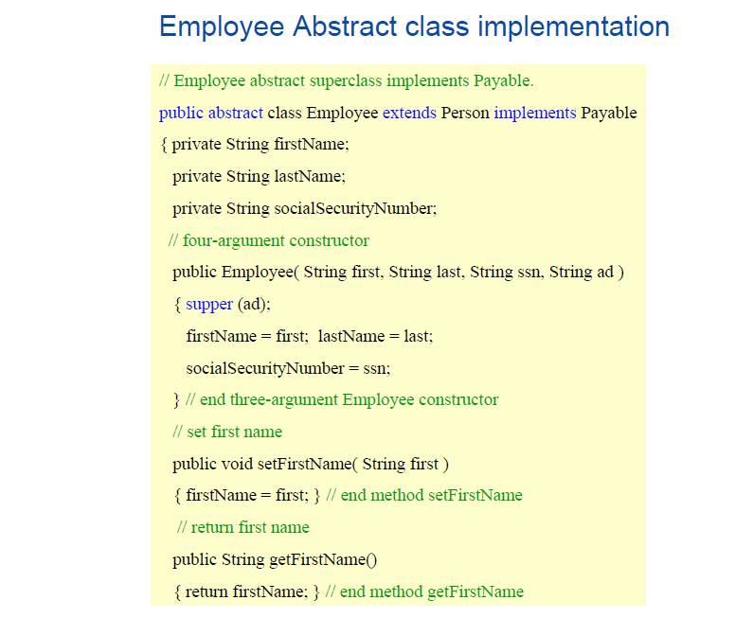

Slide 16
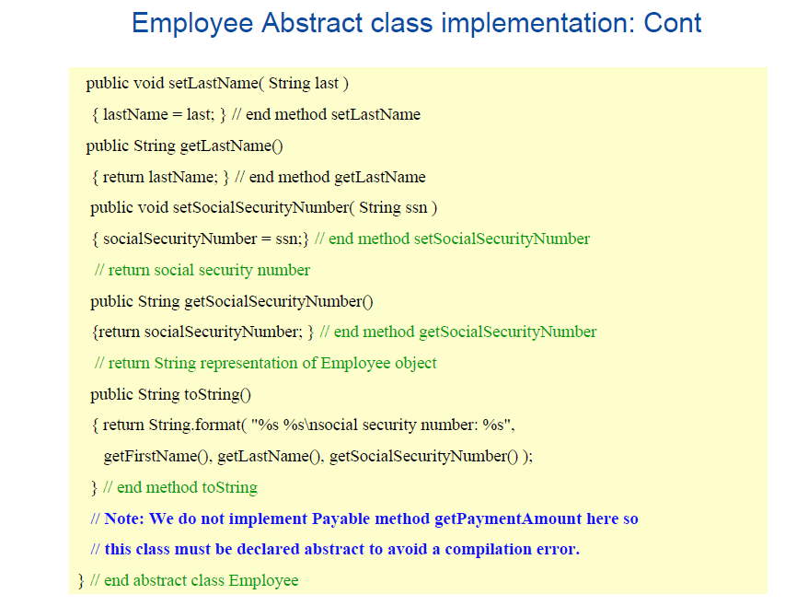

Slide 17
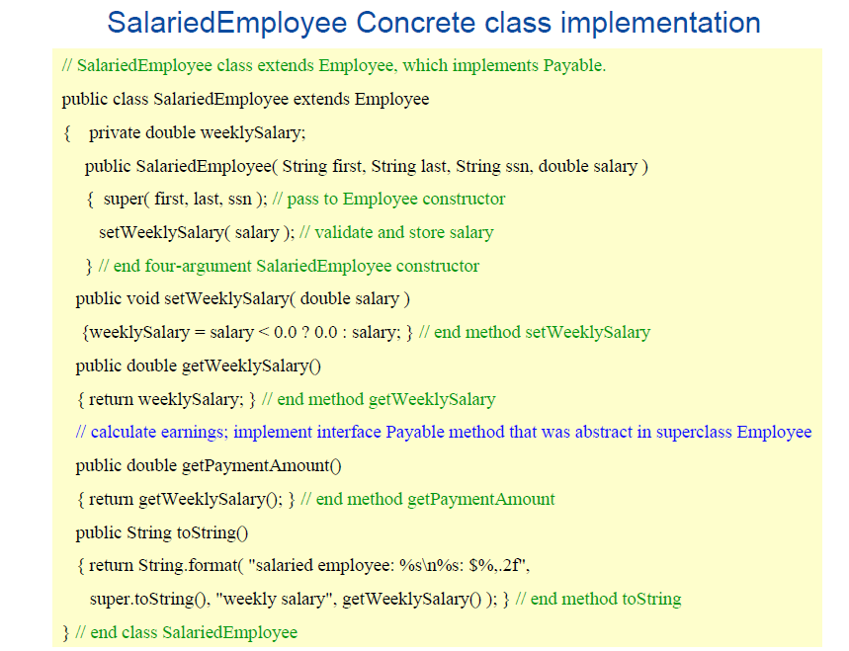
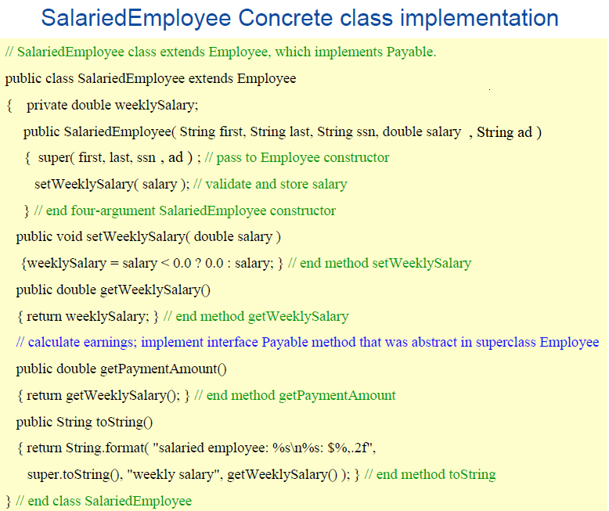
ad
, String ad

Slide 18
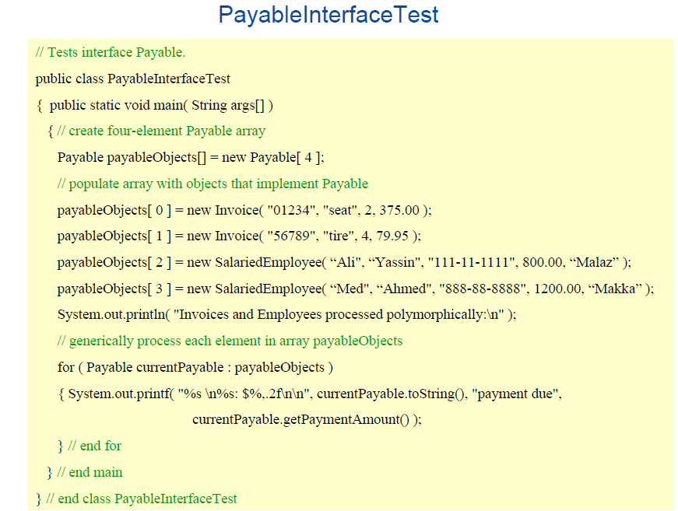
For each loop
Same as
for (int i=0; i < payableObjects.length; i++) {
Payable currentPayable = payableObjects[i];
System.out.printf (---------------------------------);
}
Notes:
For-each an array traversing technique like for loop, while loop, do-while loop
It starts with the keyword for like a normal for-loop.
Instead of declaring and initializing a loop counter variable, you declare a variable that is the same type as the base type of the array, followed by a colon, which is then followed by the array name.
In the loop body, you can use the loop variable you created rather than using an indexed array element.
It’s commonly used to iterate over an array
Syntax:
for (type var : array)
{
statements using var;
}

Slide 19
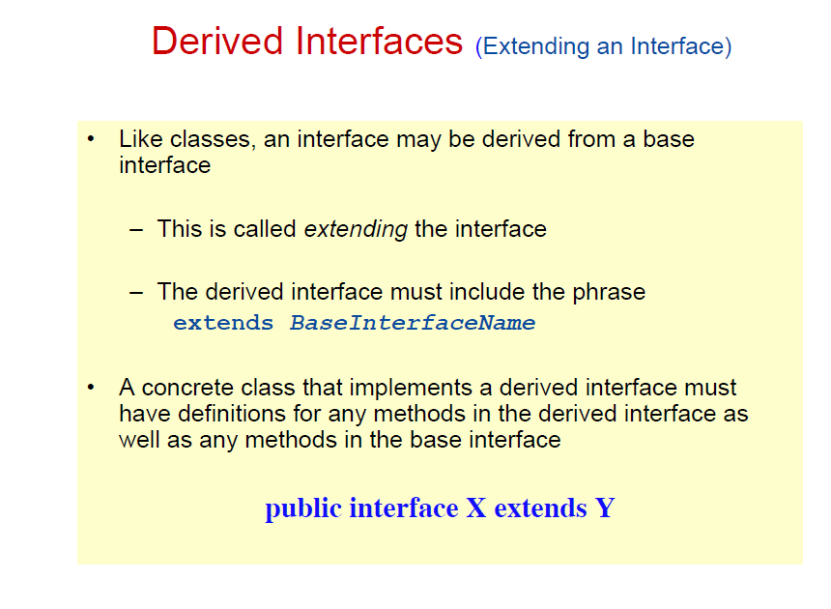

Slide 20
Derived Interfaces (Example)
interface Monster { void menace(); }
interface DangerousMonster extends Monster { void destroy(); } interface Lethal { void kill(); } class DragonZilla implements DangerousMonster { public void menace() { } public void destroy() { } }
Interface Vampire extends DangerousMonster, Lethal { void drinkBlood(); }
class VeryBadVampire implements Vampire { public void menace() { } public void destroy() { } public void kill() { } public void drinkBlood() { } }

Slide 21
When to use what?
using interfaces | using abstract classes
It is total abstraction, All methods declared within an interface must be implemented by the class(es) that implements this interface. | there are some related classes that need to share some lines of code then you can put these lines of code within abstract class and this abstract class should be extended by all these related classes.
A class can implement more than one interface. It is called multiple inheritance. | You need non-static or non-final field(s) in the class.
You want to specify the behavior of a particular data type, but not concerned about who implements its behavior. | You can expect that the classes that extend an abstract class have many common methods or fields, or require access modifiers other than public (such as protected and private).

